Slide 1
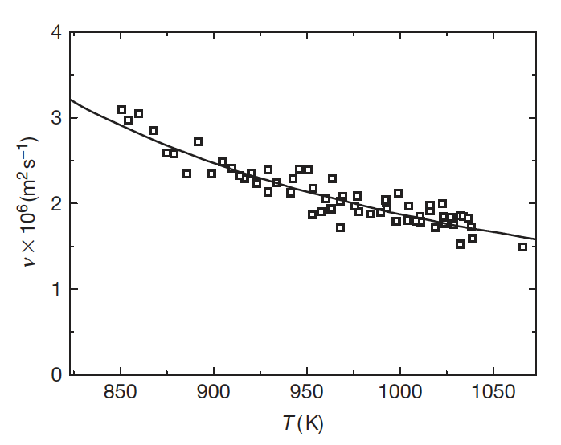
NC STATE UNIVERSITY
Salt Structure and Transport
Be–F coordination produces connected motifs in FLiBe. Composition changes the degree of association.
Local order and ion motion affect viscosity and diffusion. Mixture properties need measurement or validated models.
Scattering measurements can test molecular-dynamics predictions of salt structure.
Example transport property: kinematic viscosity
46
Notes:
Figure reused from Lec14_MoltenSalts.pptx, slide 11. Structure source: Fayfar et al., PRX Energy 3, 013002 (2024), https://www.ornl.gov/publication/complex-structure-molten-flibe-2lif-bef2-examined-experimental-neutron-scattering-x-ray . The plotted temperature trend does not itself establish the structure-composition relationship.

Slide 2
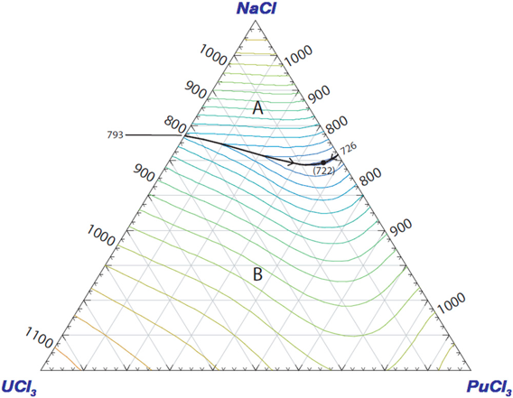
NC STATE UNIVERSITY
Salt Selection: Cold-End Margin
Locate the proposed fuel composition on the liquidus surface.
Compare its liquidus temperature with the coldest location in the circuit. Fuel loading and fission products may change the margin.
Exercise: using the NaCl–UCl₃–PuCl₃ diagram, identify a low-liquidus region. What additional property data would you need before choosing it?
47
Notes:
Figure reused from Lec14_MoltenSalts.pptx, slide 10. Background on modeling liquidus, composition, and phase stability: Besmann et al., Materials 17, 495 (2024), https://www.ornl.gov/publication/applications-thermochemical-modeling-molten-salt-reactors . Instructor prompt: require viscosity, heat capacity, actinide/fission-product solubility, neutronics, vapor pressure, and compatibility as possible answers; the diagram alone does not determine an operating salt.

Slide 3
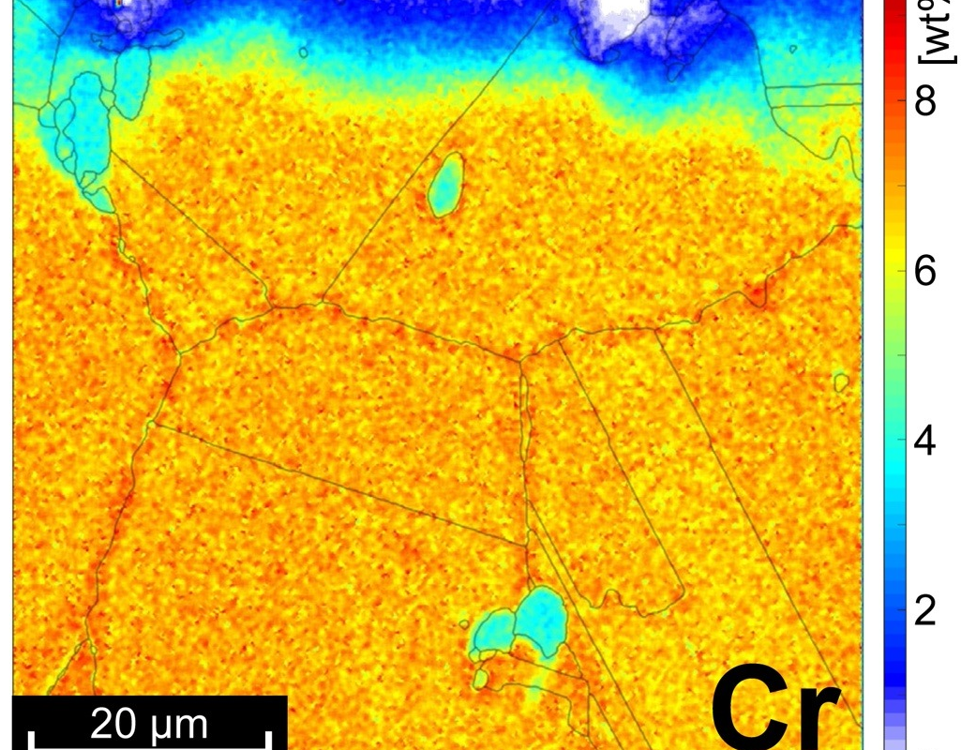
NC STATE UNIVERSITY
Redox and Selective Attack
In uranium fluoride fuel, UF₄ can oxidize Cr in the alloy to soluble CrF₂.
Salt redox sets the tendency for Cr to dissolve. Temperature, flow, and diffusion affect where and how quickly attack develops.
Exercise: what would a Cr concentration profile reveal that a single mass-loss value could miss?
Cr (wt%) near the salt-exposed edge
48
Notes:
Figure cropped from Lec14_MoltenSalts.pptx, slide 29; source DOI listed there: https://doi.org/10.1016/j.corsci.2019.108306 . Redox and corrosion context: Zhang et al., Corrosion Science 144, 44–53 (2018), https://doi.org/10.1016/j.corsci.2018.08.035 . For uranium-bearing fluoride fuel, Cr + 2 UF4 ⇌ CrF2 + 2 UF3 is a useful illustrative reaction. The image is a local profile after clean FLiNaK exposure, not direct evidence for that reaction.

Slide 4
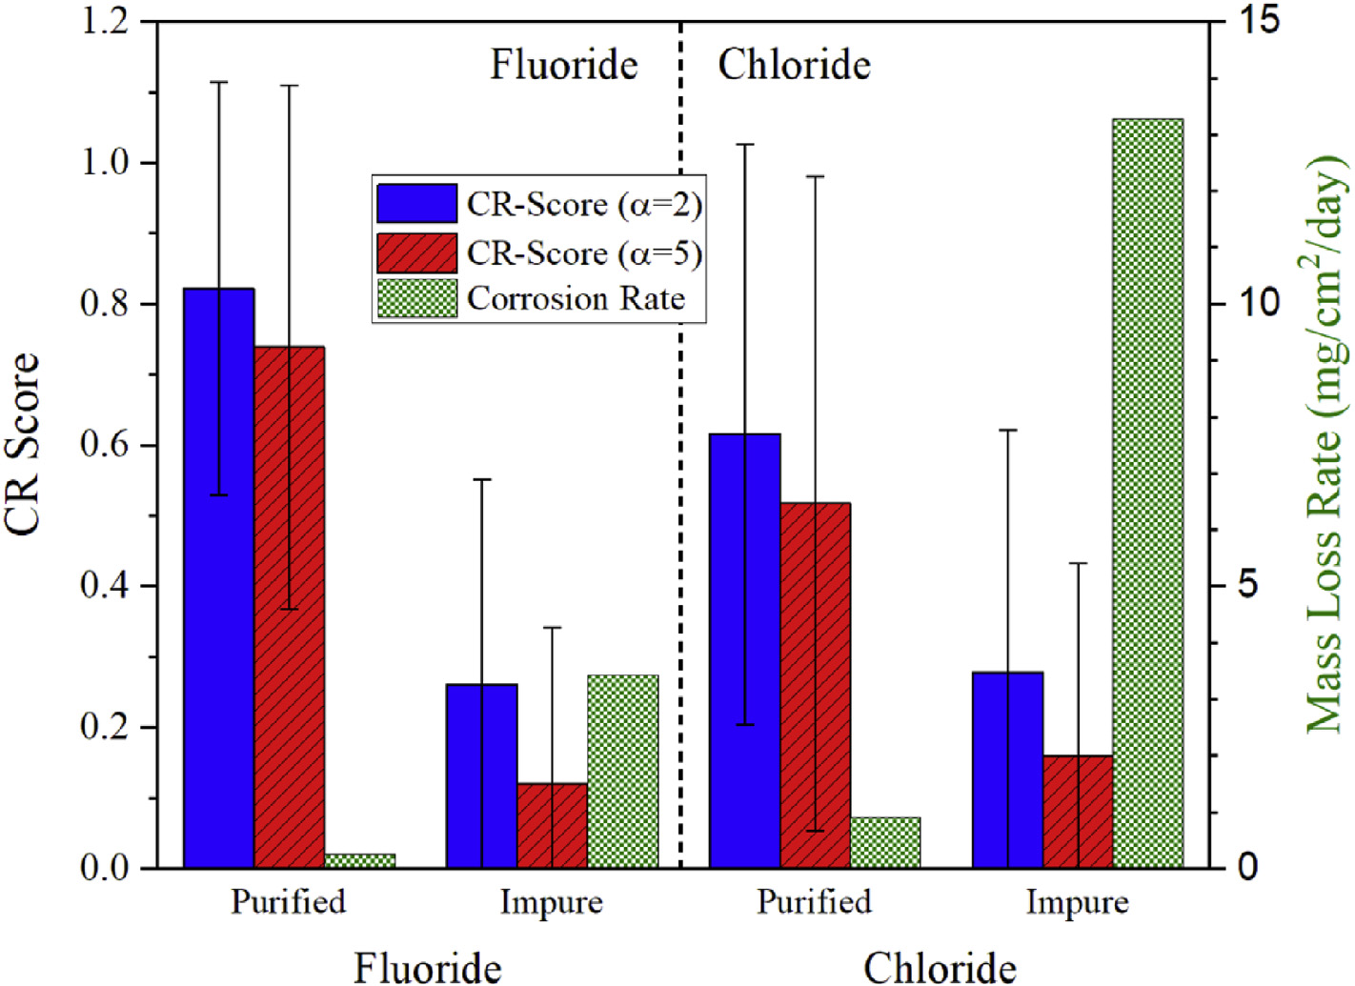
NC STATE UNIVERSITY
What Does a Corrosion Test Establish?
Static coupons isolate salt chemistry and material response. Flow loops add temperature gradients and transport.
Record impurities, redox state, temperature history, exposure geometry, and container material.
Irradiated flowing salt is needed to test the combined effects present in a fuel-salt circuit.
Impurity control changes the comparison
49
Notes:
Figure reused from Lec14_MoltenSalts.pptx, slide 45. Raiman and Lee, Journal of Nuclear Materials 511, 523–535 (2018), https://doi.org/10.1016/j.jnucmat.2018.07.036 ; https://www.ornl.gov/publication/aggregation-and-data-analysis-corrosion-studies-molten-chloride-and-fluoride-salts . Irradiation gap and staged capsule-to-loop experiments: Cooper et al. (2026), https://doi.org/10.2172/3018127 . The plotted CR-score is the authors’ aggregate metric, not a universal corrosion rate.

Slide 5
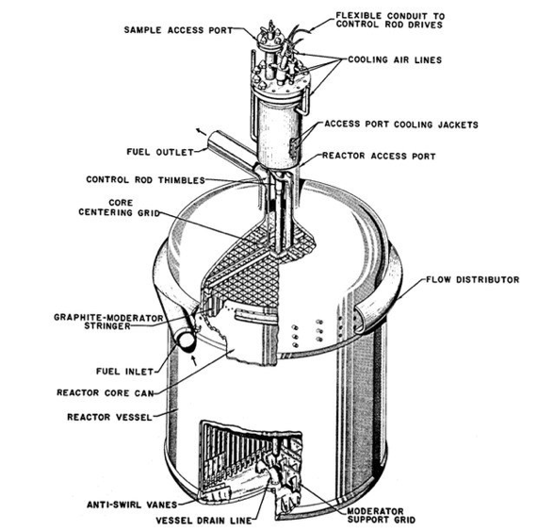
NC STATE UNIVERSITY
Freezing and Stored Fuel Salt
The coldest lines and drain system require a controlled freeze and thaw strategy.
Molten fluoride salts are relatively resistant to radiolysis. Irradiated frozen MSRE fuel salt generated F₂ during storage.
The resulting gas chemistry and migration of volatile uranium compounds became a storage and remediation problem.
MSRE vessel and drain line
50
Notes:
Figure reused from Lec13_MoltenSalts.pptx, slide 10. Solid/liquid transitions in FLiBe: Gardner et al., Journal of Applied Crystallography 58, 435–446 (2025), https://doi.org/10.1107/S1600576725000548 . Stored MSRE fuel-salt radiolysis and UF6 migration: ORNL/SPR-2018/856, Appendix B, https://info.ornl.gov/sites/publications/Files/Pub114284.pdf . This is an MSRE vessel diagram, not an image of the later storage tanks.

